Slide 1
Computer Organization and Architecture
Chapter 2

Slide 2
Bits and Bytes
The fundamental unit of information in the binary digital computer is the bit (BInarydigiT).
A bit has two values that we call 0 and 1, low and high, true and false, clear and set, and so on.
We use bits because they are easy to “make” and “read”, not because of any intrinsic value they have. If we could make three-state devices economically, we would have computers based on trits.
It is easy to represent real-world quantities as strings of bits. Sound and images can easily be converted to bits. Strings of bits can be converted back to sound or images.
We call a unit of 8 bits a byte. This is a convention. The fundamental unit of data used by most computers is an integer multiple of bytes; e.g., 1 (8 bits), 2 (16 bits), 4 (32 bits), 8 (64 bits). The size of a computer word is usually an integer power of 2.
There is no reason why a computer word can’t be 33 bits wide, or 72 bits wide. It’s all a matter of custom and tradition.

Slide 3
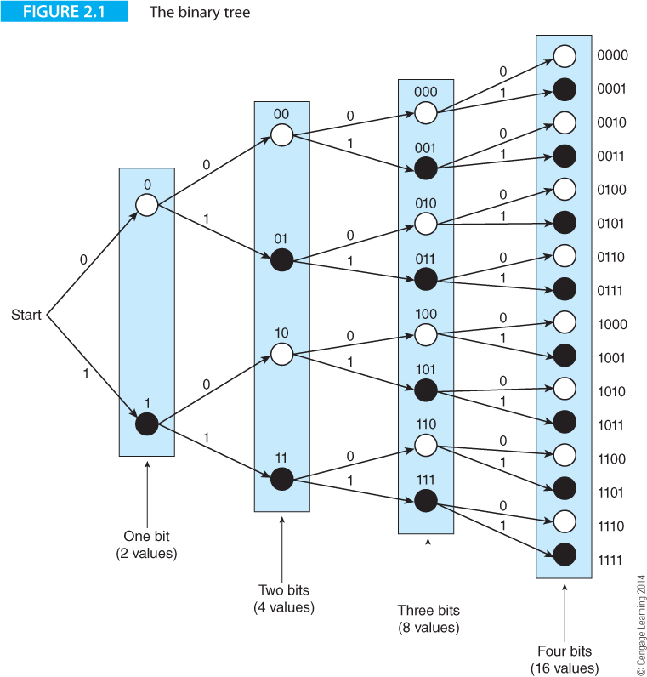
Bit Patterns
One bit can have two values, 0 and 1. Two bits can have four values, 00, 01, 10, 11. Each time you add a bit to a word, you double the number of possible combinations as Figure 2.1 demonstrates.

Slide 4
Bit Patterns
There is no intrinsically natural sequence of bit patterns. You can write all the possible patterns of 3 bits as either
0 0 0 1 0 1
0 0 1 1 0 0
0 1 0 0 0 0
0 1 1 0 0 1
1 0 0 0 1 0
1 0 1 1 1 1
1 1 0 1 1 0
1 1 1 0 1 1
The left hand column represents the binary sequence that has been universally accepted and the right hand column is an arbitrary sequence.
The left hand sequence is used because it has an important property. It makes it easy to represent decimal integers in binary form, and to perform arithmetic operations on the numbers.

Slide 5
Bit Patterns
One of the first quantities to be represented in digital from was the character (letters, numbers, and symbols). This was necessary in order to transmit text across the networks that were developed as a result of the invention of the telegraph.
This led to a standard code for characters, the ASCII code, that used 7 bits to represent up to 2⁷ = 128 characters of the Latin alphabet.
Today, the 16-bit unicode has been devised to represent a much greater range of characters including non-Latin alphabets.
Codes have been devised to represent audio (sound) values; for example, for storing music on a CD. Similarly, codes have been devised to represent images.

Slide 6
Numbers and Binary Arithmetic
One of the great advances in European history was the step from Roman numerals to the Hindu-Arabic notation that we used today.
Arithmetic is remarkably difficult using Roman numerals, but is far simpler using our positional notation system.
In positional notation, the n-digit integer N is written as a sequence of digits in the form
a_{n-1} a_{n-2} ... a_{i} … a₁ a₀
The a_{i}s are digits that can take one of b values (where b is the base). For example, in base 10 we can write N = 278 = a₂ a₁ a₀, where a₂ = 2, a₁ = 7, and a₀ = 8.

Slide 7
Positional notation can be extended to express real values by using a radix point (e.g., decimal point in base ten arithmetic or binary point in binary arithmetic) to separate the integer and fractional part.
A real value in decimal arithmetic is written in the form 1234.567.
If we use n digits in front of the radix point and m digits to the right of the radix point, we can write a_{n-1} a_{n-2} ... a_{i} … a₁ a₀ . a₋₁ a₋₂ ... a_{-m}
The value of this number expressed in positional notation in the base b is defined as
N = a_{n-1}b^{n-1} ... + a₁b¹ + a₀b⁰ + a₋₁b⁻¹ + a₋₂b⁻²... + a_{-m}b^{-m}
i=n-1
= Σ a_{i}b^{i}
i=-m

Slide 8
Warning!
Decimal positional notation cannot record all fractions exactly; for example 1/3 is 0.33333333333…33.
The same is true of binary positional notation.
Some fractions that can be represented in decimal cannot be represented in binary; for example 0.1₁₀ cannot be converted exactly into binary form.

Slide 9
Binary Arithmetic
Addition Subtraction Multiplication Addition (three bits)
0 + 0 = 0 0 - 0 = 0 0 x 0 = 0 0 + 0 + 0 = 0
0 + 1 = 1 0 - 1 = 1 (borrow 1) 0 x 1 = 0 0 + 0 + 1 = 1
1 + 0 = 1 1 - 0 = 1 1 x 0 = 0 0 + 1 + 0 = 1
1 + 1 = 0 (carry 1) 1 - 1 = 0 1 x 1 = 1 0 + 1 + 1 = 0 (carry 1)
1 + 0 + 0 = 1
1 + 0 + 1 = 0 (carry 1)
1 + 1 + 0 = 0 (carry 1)
1 + 1 + 1 = 1 (carry 1)
Because there are only two possible values for a digit, 0 or 1, binary arithmetic is very easy. These tables cover the fundamental operations of addition, subtraction, and multiplication.
The digital logic necessary used to implement bit-level arithmetic operations is trivial.

Slide 10
Real computers use 8-, 16-, 32-, and 64-bit numbers and arithmetic operations must be applied to all the bits of a word. When you add two binary words, you add pairs of bits, a column at a time, starting with the least-significant bit. Any carry-out is added to the next column on the left.
Example 1 Example 2 Example 3 Example 4
00101010 10011111 00110011 01110011
+01001101 +00000001 +11001100 +01110011
01110111 10100000 11111111 11100110
When subtracting binary numbers, you have to remember that 0 - 1 results in a difference 1 and a borrow from the column on the left.
Example 1 Example 2 Example 3 Example 4 Example 5
01101001 10011111 10111011 10110000 01100011
-01001001 -01000001 -10000100 -01100011 -10110000
00100000 01011110 00110111 01001101 -01001101

Slide 11
Decimal multiplication is difficult—we have to learn multiplication tables from 1 x 1 = 1 to 9 x 9 = 81. Binary multiplication requires a simple multiplication table that multiplies two bits to get a single-bit product.
0 x 0 = 0
0 x 1 = 0
1 x 0 = 0
1 x 1 = 1

Slide 12
The following demonstrates the multiplication of 01101001₂ (the multiplier) by 01001001₂ (the multiplicand). The product of two n-bit words is a 2n-bit value. You start with the least-significant bit of the multiplier and test whether it is a 0 or a 1. If it is a zero, you write down n zeros; if it is a 1 you write down the multiplier (this value is called a partial product). You then test the next bit of the multiplicand to the left and carry out the same operation—in this case you write zero or the multiplier one place to the left (i.e., the partial product is shifted left). The process is continued until you have examined each bit of the multiplicand in turn. Finally you add together the n partial products to generate the product of the multiplier and the multiplicand.
Multiplicand | Multiplier | Step | Partial products
01001001 | 01101001 | 1 |  |  |  |  |  |  |  | 0 | 1 | 1 | 0 | 1 | 0 | 0 | 1
01001001 | 01101001 | 2 |  |  |  |  |  |  | 0 | 0 | 0 | 0 | 0 | 0 | 0 | 0
01001001 | 01101001 | 3 |  |  |  |  |  | 0 | 0 | 0 | 0 | 0 | 0 | 0 | 0
01001001 | 01101001 | 4 |  |  |  |  | 0 | 1 | 1 | 0 | 1 | 0 | 0 | 1
01001001 | 01101001 | 5 |  |  |  | 0 | 0 | 0 | 0 | 0 | 0 | 0 | 0
01001001 | 01101001 | 6 |  |  | 0 | 0 | 0 | 0 | 0 | 0 | 0 | 0
01001001 | 01101001 | 7 |  | 0 | 1 | 1 | 0 | 1 | 0 | 0 | 1
01001001 | 01101001 | 8 | 0 | 0 | 0 | 0 | 0 | 0 | 0 | 0
 |  | Result | 0 | 0 | 1 | 1 | 1 | 0 | 1 | 1 | 1 | 1 | 1 | 0 | 0 | 0 | 1

Slide 13
Range, Precision, Accuracy and Errors
We need to introduce four vital concepts in computer arithmetic. When we process text, we expect the computer to get it right. We all expect computers to process text accurately and we would be surprised if a computer suddenly started spontaneously spelling words incorrectly. The same consideration is not true of numeric data. Numerical errors can be introduced into calculations for two reasons. The first cause of error is a property of numbers themselves and the second is an inability to carry out arithmetic operations exactly. We now define three that have important implications for both hardware and software architectures: range, precision and accuracy.
Range The variation between the largest and smallest values that can be represented by a number is a measure of its range; for example, a natural binary number in n bits has a range from 0 to 2^{n} – 1. A two’s complement signed number in n bits can represent numbers in the range -2^{n-1} to +2^{n-1} – 1. When we talk about floating-point real numbers that use scientific notation (e.g., 9.6124 x 10⁻²), we take range to means how large we can represent numbers to how small we can represent them (e.g., 0.2345 x 10²⁵ or 0.12379 x 10⁻¹⁴). Range is particularly important in scientific applications when we represent astronomically large values such as the size of the galaxy or a banker’s bonus, to microscopically small numbers such as the mass of an electron.

Slide 14
Precision The precision of a number is a measure of how well we can represent it; for example π cannot be exactly represented by a binary or a decimal real number – no matter how many bits we take. If we use five decimal digits to represent π we say that its precision is 1 on 10⁵. If we take 20 digits we represent to one part in 10²⁰.
Accuracy The difference between the representation of a number and its actual value is a measure of its accuracy; for example, if we measure the temperature of a liquid as 51.32 and its actual temperature is 51.34 , the accuracy is 0.02. It is tempting to confuse accuracy and precision. They are not the same. For example, the temperature of the liquid may be measured as 51.320001 which is a precision of 8 significant figures, but, if its actual temperature is 51.34 the accuracy is only to three significant figures.
Errors You could say that an error is a measure of accuracy; that is, error = true value – actual value. This is true. However, what matters to us as computer designers, programmers, and users is how errors arise, how they are controlled, and how their effects are minimalized.

Slide 15
Range, Precision, Accuracy and Errors
A good example of the problems of precision and accuracy in binary arithmetic arises with binary fractions. A decimal integer can be exactly represented in binary form given sufficient bits for the representation. In positional notation the bits of a binary fraction are 0.1₂ = 0.5, 0.01₂ = 0.25, 0.001₂ = 0.125, 0.0001₂ = 0.0625₁₀. Not all decimal fractions cannot be represented exactly in binary form. For example, 0.1₁₀ = 0.000110011001100110011…₂. In 32 bits you can achieve a precision of 1 on 2³².
Probably the most documented failure of decimal/binary arithmetic is the Patriot Missile failure. A Patriot antimissile is intended to detonate and release about 1,000 pellets in front of its target at a distance of 5 – 10 m. Any further away and the chance of sufficient pellets being able to destroy the target is very low.
The Patriot’s software uses 24-bit precision arithmetic and the system clock is updated every 0.1 second. The tracking accuracy is related to the absolute error in the accumulated time; that is the error increases with time.
In 1991 during the first Iraq war a Patriot battery at Dhahran has been operating for over 100 hours. The accumulated error in the clock had 0.3433s which corresponds to an error in the estimation of the target position of about 667 m. An incoming SCUD was not intercepted and 28 US soldiers were killed.

Slide 16
Signed Integers
Negative numbers can be represented in many different ways. Computer designers have adopted three techniques: sign and magnitude, two’s complement, and biased representation.
Sign and Magnitude Representation
An n-bit word has 2^{n} possible values from 0 to 2^{n} – 1; for example, an eight-bit word can represent the numbers 0, 1,..., 254, 255. One way of representing a negative number is to take the most-significant bit and reserve it to indicate the sign of the number.
By convention 0 represents positive numbers and 1 represents negative numbers.
The value of a sign and magnitude number as (-1)^{S} x M, where S is the sign bit and M is its magnitude. If S = 0, (-1)⁰ = +1 and the number is positive. If S = 1, (-1)¹ = -1 and the number is negative; for example, in 8 bits we can interpret the numbers 00001101 and 10001101 as +13 and -13.
Sign and magnitude representation is not generally used because it requires separate adders and subtractors. However, it is used in floating-point arithmetic.

Slide 17
Complementary Arithmetic
A number and its complement add up to a constant; for example in nines complement arithmetic a digit and its complement add up to nine; the complement of 2 is 7 because 2 + 7 = 9. In n-bit binary arithmetic, if P is a number then its complement is Q and P + Q = 2^{n}.
In binary arithmetic, the two’s complement of a number is formed by inverting the bits and adding 1.
The twos complement of 01100101 is 10011010+1 = 10011011.
We are interested in complementary arithmetic because subtracting a number is the same as adding a complement.
To subtract 01100101 from a binary number, we just add its complement 100111011.

Slide 18
Two’s Complement Arithmetic
The two’s complement of an n-bit binary value, N, is defined as 2^{n} - N.
If N = 5 = 00000101 (8-bit arithmetic), the two’s complement of N is given by
2⁸ - 00000101 = 100000000 - 00000101 = 11111011.
11111011 represents -00000101 (-5) or +123 depending only on whether we interpret 11111011 as a two’s complement integer or as an unsigned integer.
This example demonstrates 8-bit two’s complement arithmetic. We begin by writing down the representations of +5, -5, +7 and -7.
+5 = 00000101 -5 = 11111011 +7 = 00000111 -7 = 11111001
We can now add the binary value for 7 to the two’s complement of 5.
00000111 7
+11111011 -5
100000010 2
The result is correct if the left hand carry-out is ignored.

Slide 19
Two’s Complement Arithmetic
Now consider the addition of -7 to +5.
00000101 5
+11111001 -7
11111110 -2
The result is 11111110 (the carry bit is 0).
The expected answer is –2; that is, 2⁸ – 2 = 100000000 – 00000010 = 11111110.
Two’s complement arithmetic is not magic. Consider the calculation Z = X - Y in n-bit arithmetic which we do by adding the two’s complement of Y to X. The two’s complement of Y is defined as 2^{n} - Y. We get
Z = X + (2^{n} - Y) = 2^{n} + (X - Y).
This is the desired result, X - Y, together with an unwanted carry-out digit (i.e., 2^{n}) in the leftmost position that is discarded.

Slide 20
Two’s Complement Arithmetic
Let X = 9 = 00001001 and Y = 6 = 00000110
-X = 100000000 - 00001001 = 11110111
-Y = 100000000 - 00000110 = 11111010
1. +X +9 00001001 2. +X +9 00001001
+Y +6 +00000110 -Y -6 +11111010
00001111 = 15 100000011 = +3
3. -X -9 11110111 4. -X -9 11110111
+Y +6 +00000110 -Y -6 +11111010
11111101 = -3 111110001 = -15
All four examples give the result we'd expect when the result is interpreted as a two’s complement number.

Slide 21
Two’s Complement Arithmetic
Properties of Two’s complement Numbers
1. The two’s complement system is a true complement system in that +X + (-X) = 0.
2. There is one unique zero 00...0.
3. The most-significant bit of a two’s complement number is a sign bit. The number is positive if the most-significant bit is 0, and negative if it is 1.
4. The range of an n-bit two’s complement number is from -2^{n-1} to +2^{n-1} - 1. For n = 8, the range is ‑128 to +127. The total number of different numbers is 2^{n} = 256 (128 negative, zero and 127 positive).

Slide 22
Arithmetic Overflow
The range of two’s complement numbers in n bits is from -2^{n-1} to +2^{n-1} - 1. Consider what happens if we violate this rule by carrying out an operation whose result falls outside the range of values that can be represented by two’s complement numbers. In a five-bit representation, the range of valid signed numbers is -16 to +15.
Case 1 Case 2
5 = 00101 12 = 01100
+7 = 00111 +13 = 01101
12 01100 = 12₁₀ 25 11001 = -7₁₀ (as a two's complement value)
In Case 1 we get the expected answer of +12₁₀, but in Case 2 we get a negative result because the sign bit is '1'.
If the answer were regarded as an unsigned binary number it would be +25, which is, of course, the correct answer. However, once the two’s complement system has been chosen to represent signed numbers, all answers must be interpreted in this light.

Slide 23
If we add together two negative numbers whose total is less than -16, we also go out of range. For example, if we add -9 = 10111₂ and -12 = 10100₂, we get:
-9 = 10111
-12 = +10100
-21 101011 gives a positive result 01011₂ = +11₁₀

Slide 24
Both examples demonstrate arithmetic overflow that occurs during a two’s complement addition if the result of adding two positive numbers yields a negative result, or if adding two negative numbers yields a positive result.
If the sign bits of A and B are the same but the sign bit of the result is different, arithmetic overflow has occurred.
If a_{n-1} is the sign bit of A, b_{n-1} is the sign bit of B, and s_{n-1} is the sign bit of the sum of A and B, then overflow is defined by the logical
V = a_{n-1}* ⋅b _{n-1}* ⋅s _{n-1} + a _{n-1}⋅b _{n-1}⋅ s _{n-1}*
In practice, real systems detect overflow from the carry bits into and out of the most-significant bit of an adder; that is, V= C_{in} ≠ C_{out}.
Arithmetic overflow is a consequence of two’s complement arithmetic and shouldn't be confused with carry-out, which is the carry bit generated by the addition of the two most-significant bits of the numbers.

Slide 25
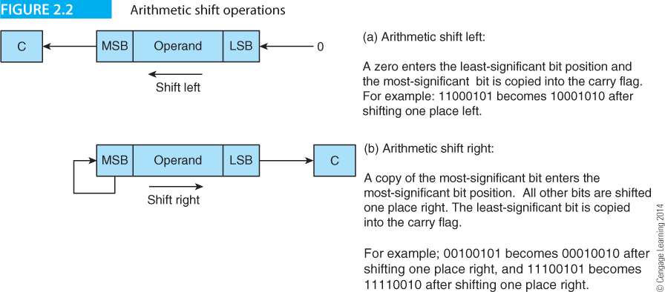
Shifting Operations
In a shift operation, the bits of a word are shifted one or more places left or right. If the bit pattern represents a two’s complement integer, shifting it left multiplies it by 2.
Consider the string 00100111 (39). Shifting it one place left, gives 01001110 (78). Figure 2.2(a) describes the arithmetic shift left. A zero enters into the vacated least-significant bit position and the bit shifted out of the most-significant bit position is recorded in the computer's carry flag.
If 11100011 (-29) is shifted one place left it becomes 11000110 (-58).

Slide 26
Floating-point Numbers
Floating-point arithmetic lets you handle the very large and very small numbers found in scientific applications.
A floating-point value is stored as two components: a number and the location of the radix point within the number.
Floating-point is also called scientific notation, because scientists use it to represent large and small numbers, e.g. 1.2345 x 10²⁰, 0.45679999 x 10⁻⁵⁰, -8.5 x 10³.
A binary floating-point number is represented by mantissa x 2^{exponent}; for example, 101010.111110₂ can be represented by 1.01010111110 x 2⁵, where the significand is 1.01010111110 and the exponent 5 (the exponent is 00000101 in 8-bit binary arithmetic).
The term mantissa has been replaced by significand to indicate the number of significant bits in a floating-point number.
Because a floating-point number is defined as the product of two values, a floating-point value is not unique; for example 10.110 x 2⁴ = 1.011 x 2⁵.

Slide 27
Normalization of Floating-point Numbers
An IEEE-754 floating-point significand is always normalized (unless it is equal to zero) and is in the range 1.000…0 x 2e to 1.111…1 x 2e. A normalized number always begins with a leading 1.
Normalization allows the highest available precision by using all significant bits. If a floating-point calculation were to yield the result 0.110... x 2e, the result would be normalized to give 1.10... x 2^{e -1}.
Similarly, the result 10.1... x 2e would be normalized to 1.01... x 2^{e+1}.
A number smaller than 1.0…00 x 2^{e+1} cannot be normalized.
Normalizing a significand takes full advantage of the available precision; for example, the unnormalized 8-bit significand 0.0000101 has only four significant bits, whereas the normalized 8-bit significand 1.0100011 has eight significant bits.

Slide 28
Biased Exponents
The significand of an IEEE format floating-point number is represented in sign and magnitude form.
The exponent is represented in a biased form, by adding a constant to the true exponent.
Suppose an 8-bit exponent is used and all exponents are biased by 127. If a number's exponent is 0, it is stored as 0 + 127 = 127.
If the exponent is –2, it is stored as –2 + 127 = 125. A real number such as 1010.1111 is normalized to get +1.0101111 x 2³.
The true exponent is +3, which is stored as a biased exponent of 3 + 127; that is 130₁₀ or 10000010 in binary form.

Slide 29
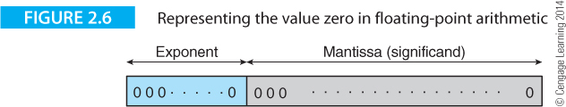
The advantage of the biased representation of exponents is that the most negative exponent is represented by zero.
The floating-point value of zero is represented by 0.0...0 x 2^{most negative exponent} (see Figure 2.6).
By choosing the biased exponent system we arrange that zero is represented by a zero significand and a zero exponent as Figure 2.6 demonstrates.

Slide 30
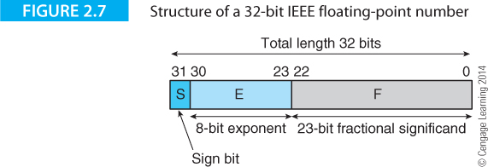
A 32-bit single precision IEEE 754 floating-point number is represented by the bit sequence
S EEEEEEEE 1.MMMMMMMMMMMMMMMMMMMMMM
where S is the sign bit, E the eight-bit biased exponent that tells you where to put the binary point, and M the 23-bit fractional significand.
The leading 1 in front of the significand is omitted when the number is stored in memory.

Slide 31
The significand of an IEEE floating-point number is normalized in the range 1.0000...00 to 1.1111...11, unless the floating-point number is zero, in which case it is represented by 0.000...00.
Because the significand is normalized and always begins with a leading 1, it is not necessary to include the leading 1 when the number is stored in memory. A floating-point number X is defined as:
X = -1^{S} x 2^{E - B} x 1.F where,
S = sign bit, 0 = positive significand, 1 = negative significand
E = exponent biased by B
F = fractional significand (the significand is 1.F with an implicit leading one)

Slide 32
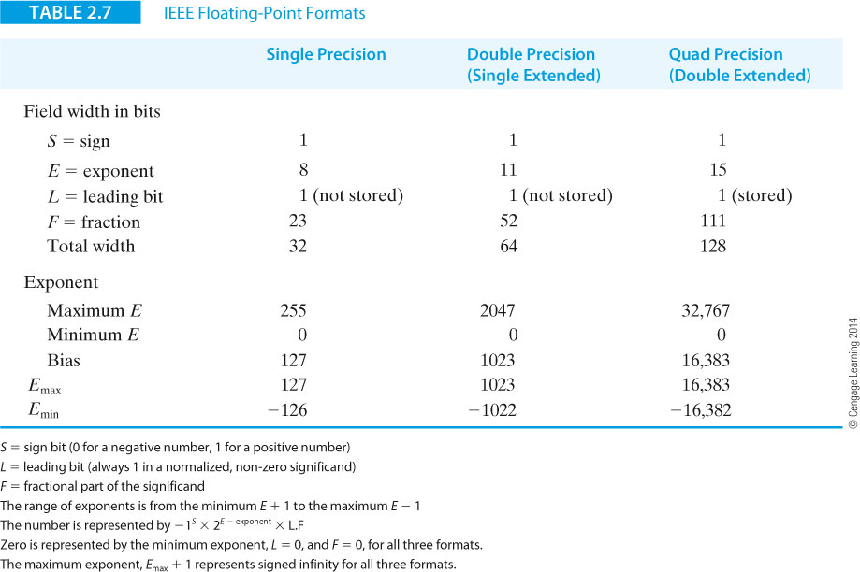

Slide 33
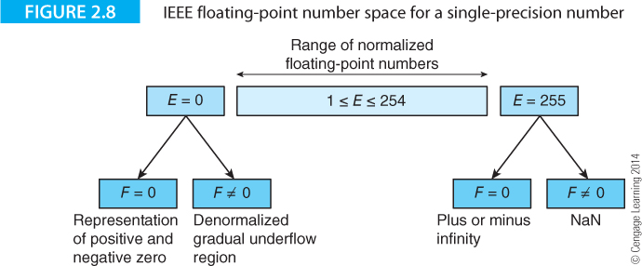

Slide 34
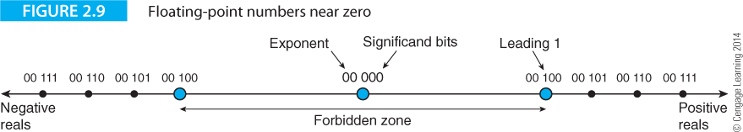
Figure 2.9 demonstrates a floating point system with a two-bit exponent with a 2-bit stored significand.
The value zero is represented by 00 000. The next positive normalized value is represented by 00 100 (i.e., 2^{-b} x 1.00 where b is the bias).
There is a forbidden zone around zero where floating-point values can’t be represented because they are not normalized.
This region where the exponent is zero and the leading bit is also zero, is still used to represent valid floating-point numbers. Such numbers are unnormalized and have a lower precision than normalized numbers, thus providing gradual underflow.

Slide 35
Example of Decimal to Binary floating-point Conversion
Converting 4100.125₁₀ into a 32-bit single-precision IEEE floating-point value.
Convert 4100.125 into a fixed-point binary to get 4100₁₀ = 1000000000100₂ and 0.125₁₀ = 0.001₂. Therefore, 4100.125₁₀ = 1000000000100.001₂.
Normalize 1000000000100.001₂ to 1.000000000100001 x 2¹².
The sign bit, S, is 0 because the number is positive
The exponent is the true exponent plus 127; that is, 12 + 127 = 139₁₀ = 10001011₂
The significand is 00000000010000100000000 (the leading 1 is stripped and the significand expanded to 23 bits).
The final number is 01000101100000000010000100000000, or 45802100₁₆.

Slide 36
Let’s carry out the reverse operation with C46C0000₁₆. In binary form, this number is 11000100011011000000000000000000.
First unpack the number into sign bit, biased exponent, and fractional significand.
S = 1
E = 10001000
M =11011000000000000000000
As the sign bit is 1, the number is negative.
We subtract 127 from the biased exponent 10010000₂ to get the exponent 1001000₂ - 01111111₂ = 00000111₂ = 7₁₀.
The fractional significand is .11011000000000000000000₂.
Reinserting the leading one gives 1.11011000000000000000000₂.
The number is -1.11011000000000000000000₂ x 2⁷, or ‑11101100₂ (i.e., ‑236.0₁₀).

Slide 37
Floating-point Arithmetic
Floating-point numbers can't be added directly.
Consider an example using a 8-bit significand and an unbiased exponent with A = 1.0101001 x 2⁴ and B = 1.1001100 x 2³. To multiply these numbers you multiply the significands and add the exponents; that is,
A.B = 1.0101001 x 2⁴ x 1.1001100 x 2³
= 1.0101001 x 1.1001100 x 2³⁺⁴
= 1.000011010101100 x 2⁸.
Now let’s look at addition. If these two floating-point numbers were to be added by hand, we would automatically align the binary points of A and B as follows.
10101.001
+ 1100.1100
100001.1110

Slide 38
However, as these numbers are held in a normalized floating-point format the computer has the following problem of adding
1.0101001 x 2⁴
+1.1001100 x 2³
The computer has to carry out the following steps to equalize exponents.
1. Identify the number with the smaller exponent.
2. Make the smaller exponent equal to the larger exponent by dividing the significand of the smaller number by the same factor by which its exponent was increased.
3. Add (or subtract) the significands.
If necessary, normalize the result (post normalization).
We can now add A to the denormalized B.
A = 1.0101001 x 2⁴
B = +0.1100110 x 2⁴
10.0001111 x 2⁴

Slide 39
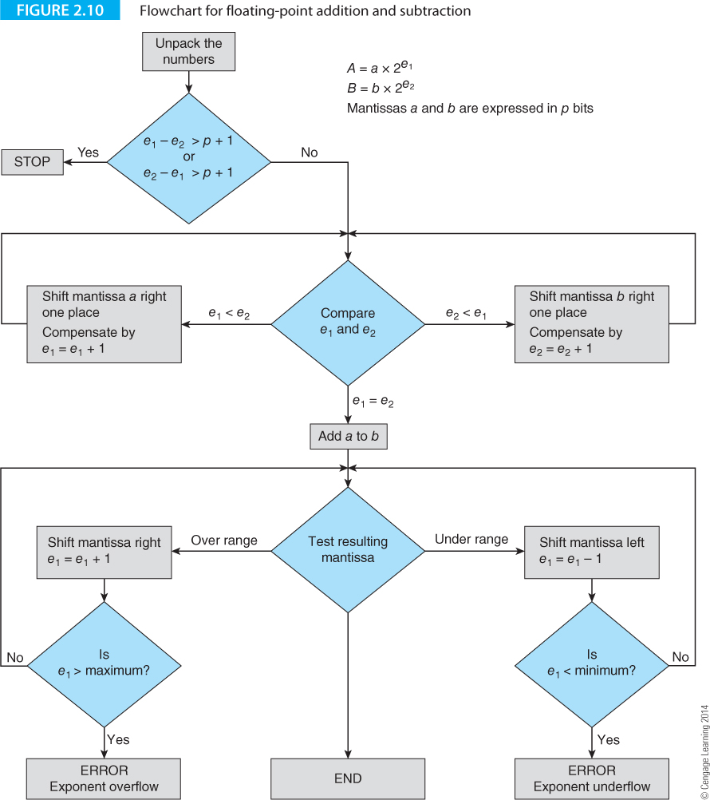
Instruction Formats

Slide 40
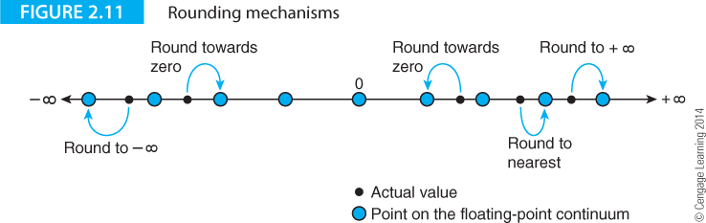
Rounding
The simplest rounding mechanism is truncation or rounding towards zero. In rounding to nearest, the closest floating-point representation to the actual number is used.
In rounding to positive or negative infinity, the nearest valid floating-point number in the direction positive or negative infinity respectively is chosen.
When the number to be rounded is midway between two points on the floating-point continuum, IEEE rounding specifies the point whose least-significant digit is zero (i.e., round to even).

Slide 41
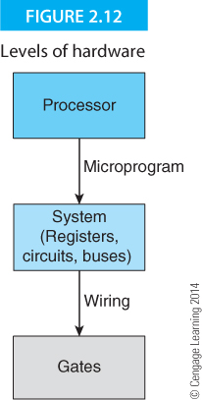
Computer Logic
Computers are constructed from two basic circuit elements — gates and flip-flops, known as combinational and sequential logic elements.
A combinational logic element is a circuit whose output depends only on its current inputs, whereas the output from a sequential element depends on its past history as well as its current inputs.
A sequential element can remember its previous inputs and is therefore also a memory element. Sequential elements themselves can be made from simple combinational logic elements.

Slide 42
Logic Values
Unless explicitly stated, we employ positive logic in which the logical 1 state is the electrically high state of a gate. This high state can also be called the true state, in contrast with the low state that is the false state.
Each logic state has an inverse or complement that is the opposite of its current state. The complement of a true or one state is a false or zero state, and vice versa. By convention we use an overbar to indicate a complement.
A signal can have a constant value or a variable value. If it is a constant it always remains in that state. If it is a variable, it may be switched between the states 0 and 1. A Boolean constant is frequently called a literal.
If a high level causes an action, the variable is called active-high. If a low level causes the action, the variable is called active-low.
The term asserted indicates that a signal is placed in the level that causes its activity to take place; for example, if we say that START is asserted, we mean that it is placed in a high state to cause the action determined by START. If we say that LOAD is asserted, it is placed in a low state to trigger the action.

Slide 43
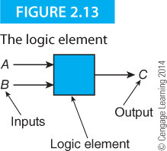
Gates
All digital computers can be constructed from three types of gate: AND, OR, and NOT gates, together with flip-flops. Because flip-flops can be constructed from gates, all computers can be constructed from gates alone. Moreover, because the NAND gate, can be used to synthesize AND, OR, and NOT gates, any computer can be constructed from nothing more than a large number of NAND gates.
Fundamental Gates
Figure 2.14 shows a black box with two input terminals, A and B, and a single output terminal C. This device takes the two logic values at its input terminals and produces an output that depends only on the states of the inputs and the nature of the logic element.

Slide 44
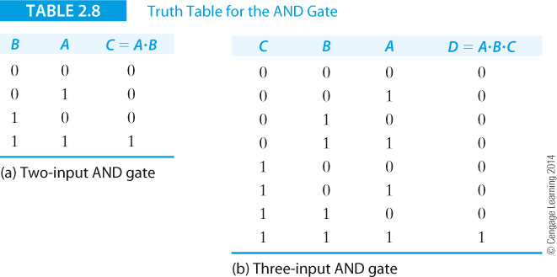
The AND Gate
The behavior of a gate is described by its truth table that defines its output for each of the possible inputs.
Table 2.8a provides the truth table for the two-input AND gate. If one input is A and the other B, output C is true (i.e., 1) if and only if both inputs A and B are both 1.

Slide 45
Table 2.8b gives the truth table for an AND gate with three inputs A, B, and C and an output D = A⋅B⋅C. In this case D is 1 only when inputs A and B and C are each 1 simultaneously.

Slide 46
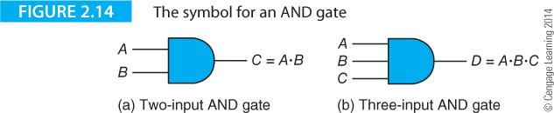
Figure 2.14 gives the symbols for 2-input and 3-input AND gates

Slide 47
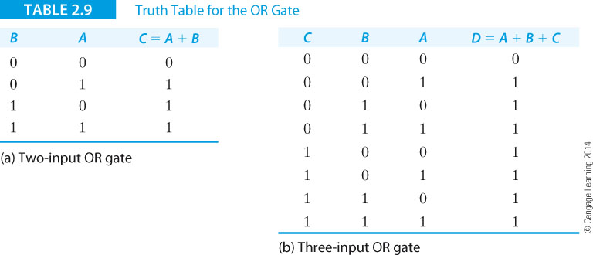
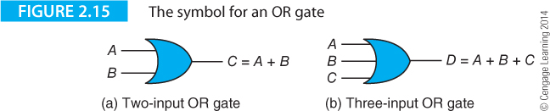
The OR Gate
The output of an OR gate is 1 if either one or more of its inputs are 1. The only way to make the output of an OR gate go to a logical 0 is to set all its inputs to 0. The OR is represented “+”, so that the operation A OR B is written A + B.

Slide 48
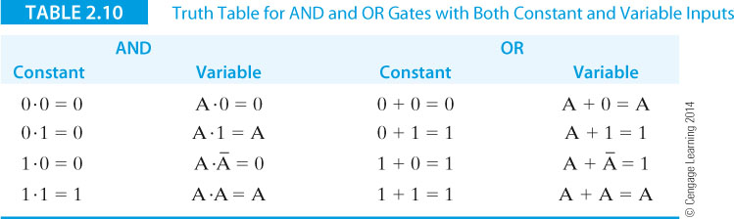
Comparing AND and OR Gates

Slide 49
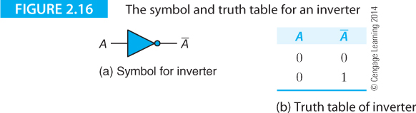
The NOT gate or invertor

Slide 50
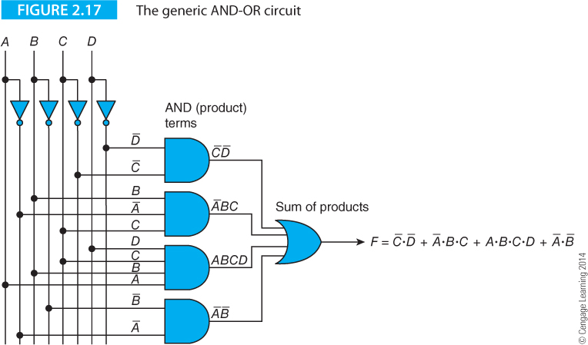
Example of a digital circuit
This is called a sum of products circuit. The output is the OR of AND terms

Slide 51
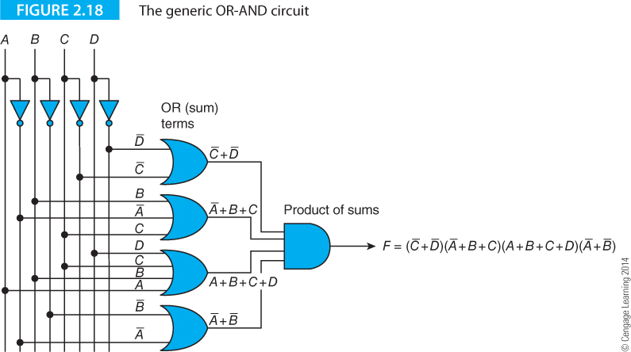
Example of a digital circuit
This is called a product of sums circuit. The output is the AND of OR terms

Slide 52
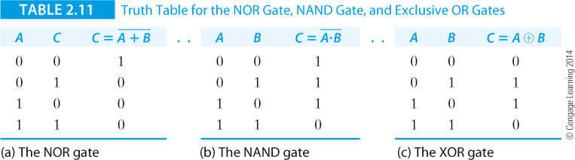
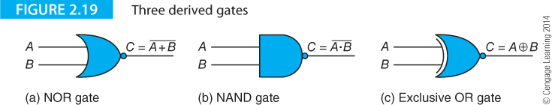
Derived Gates NOR, NAND, Exclusive OR
Three gates can be derived from basic gates. These are used extensively in digital circuits and have their own symbols.
A NAND gate is an AND followed by and invertor and a NOR gate is an OR followed by an invertor. An XOR gate is an OR gate whose output is true only if one input is true.

Slide 53
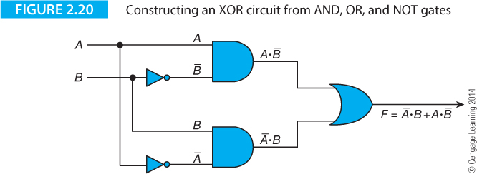
Exclusive OR
The Exclusive OR function is written XOR or EOR and uses the symbol ⊕ (e.g., C = A⊕B).
An XOR gate can be constructed from two inverters, two AND gates and an OR gate, as Figure 2.20 demonstrates. A⊕B = A⋅B* + A * ⋅B.

Slide 54
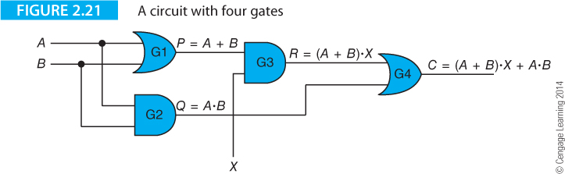
Example of a digital circuit
Figure 2.21 describes a circuit with four gates, labeled G1, G2, G3 and G4. Lines that cross each other without a dot at their intersection are not connected together—lines that meet at a dot are connected. This circuit has three inputs A, B, and X, and an output C. It also has three intermediate logical values labeled P, Q, and R.
We can treat a gate as a processor that operates on its inputs according to its logical function; for example, the inputs to AND gate G3 are P and X, and its output is P⋅X. Because P = A + B, the output of G3 is (A + B)⋅X. Similarly the output of gate G4 is R + Q, which is (A + B)⋅X + A⋅B.

Slide 55
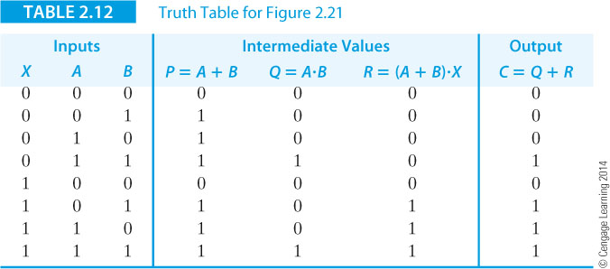
Example of a digital circuit
Table 2.12 gives the truth table for Figure 2.21. Note that the output corresponds to the carry out of a 3-bit adder.

Slide 56
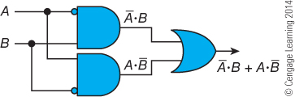
Inversion Bubbles
By convention, invertors are often omitted from circuit diagrams and bubble notation is used.
A small bubble is placed at a gate’s input to indicate inversion.
In the circuit below, the two AND gates form the produce of NOT A AND B, and A AND NOT B.

Slide 57
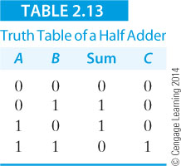
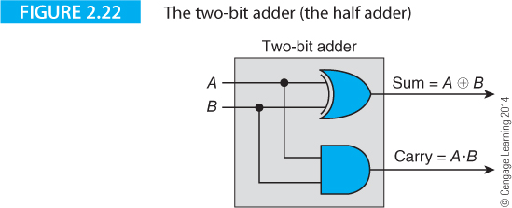
The Half Adder and Full Adder
Table 2.13 gives the truth table of a half adder that adds bit A to bit B to get a sum S and a carry.
Figure 2.22 shows the possible structure of a two-bit adder. The carry bit is generated by ANDing the two inputs.

Slide 58
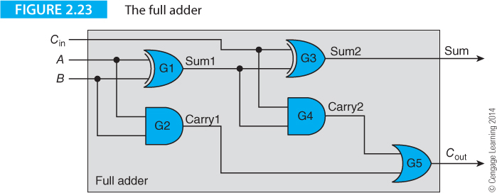
Full Adder Circuit
Figure 2.3 gives the possible circuit of a one-bit full adder.

Slide 59
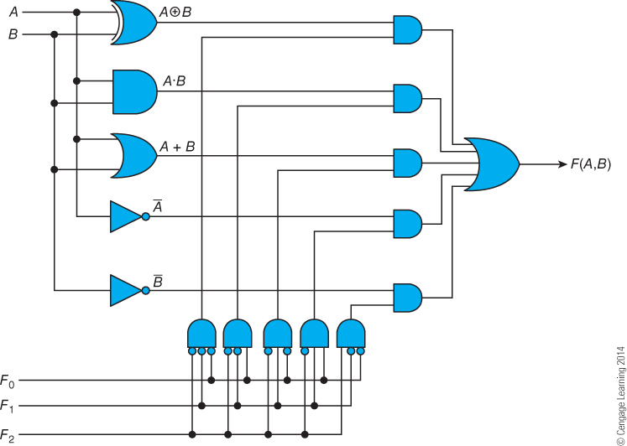
One Bit of an ALU
This diagram describes one bit of a primitive ALU that can perform five operations on bits A and B (XOR, AND, OR NOT A and NOT B). The function performed is determined by the three-bit control signal F₂,F₁,F₀.
The five functions are generated by the five gates on the left. On the right, five AND gates gate the selected function to the output. The gates along the bottom decode the function select input into one-of-five to gate the required function to the output.

Slide 60
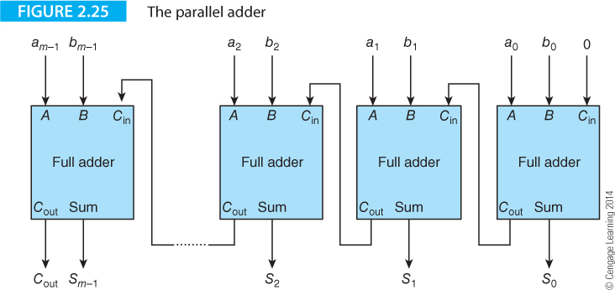
Full Adder
We need m full adder circuits to add two m-bit words in parallel as Figure 2.25 demonstrates. Each of the m full adders adds bit a_{i} to bit b_{i}, together with a carry-in from the stage on its right, to produce a carry-out to the stage on its left.

Slide 61
This circuit is called a parallel adder because all the bits of the two words to be added are presented to it at the same time.
The circuit is not truly parallel because bit a_{i} cannot be added to bit b_{i} until the carry-in bit c_{i-1} has been calculated by the previous stage. This is a ripple through adder because addition is not complete until the carry bit has rippled through the circuit. Real adders use high-speed carry look ahead circuits to generate carry bits more rapidly and speed addition.

Slide 62
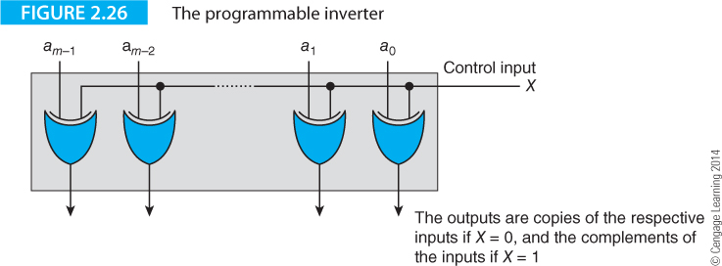

Slide 63
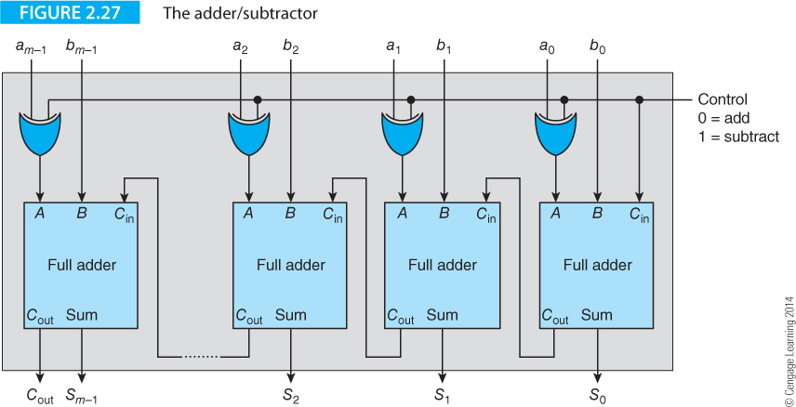
Full Adder/Subtractor

Slide 64
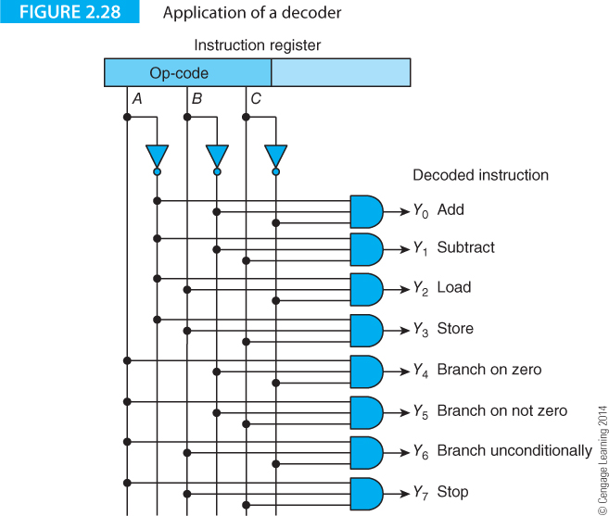
Let’s look at some of the interesting things you can do with a few gates. Figure 2.29 has three inputs A, B, and C, and eight outputs Y0 to Y7. The three inverters generate the complements of the inputs A, B, and C. Each of the eight AND gates is connected to three of the six lines (each of the three variables appear in either its true or complemented form).

Slide 65
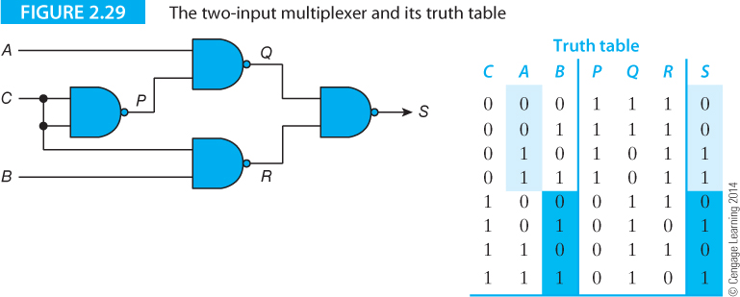

Slide 66
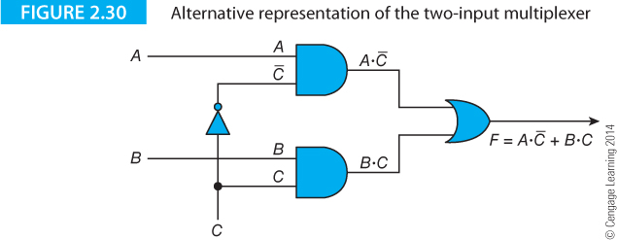

Slide 67
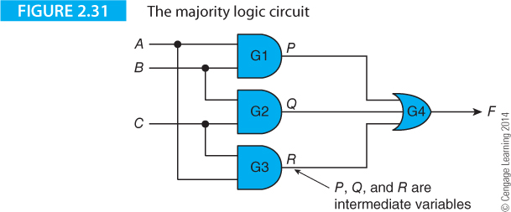
Figure 2.31 illustrates a 3-input majority logic (or voting) circuit whose output corresponds to the state of the majority of the inputs. This circuit uses three 2-input AND gates labeled G1, G2, and G3, and a 3-input OR gate labeled G4, to generate an output F.

Slide 68
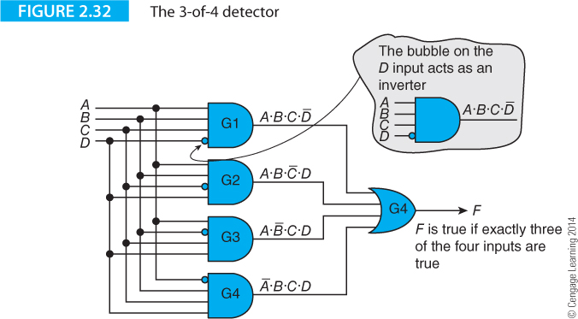
An alternative means of representing an inverter. An inverting bubble is shown at the appropriate inverting input of each AND gate.
This inverting bubble can be applied at the input or output of any logic device.

Slide 69
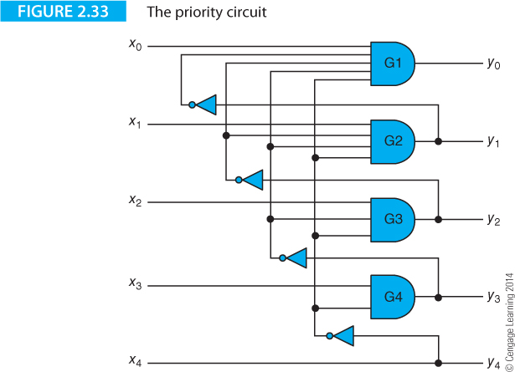
The Prioritizer
Figure 2.34 describes the prioritizer, a circuit that deals with competing requests for attention and is found in multiprocessor systems where several processors can compete for access to memory..

Slide 70
Sequential Circuits
All the circuits we’ve looked at have one thing in common; their outputs are determined only by the inputs and the configuration of the gates. These circuits are called combinational circuits.
We now look at a circuit whose output is determined by its inputs, the configuration of its gates, and its previous state. Such a device is called a sequential circuit and has the property of memory, because its current state is determined by its previous state.
The fundamental sequential circuit building block is known as a bistable because its output can exist in one of two stable states. By convention, a bistable circuit that responds to the state of its inputs at any time is called a latch, whereas a bistable element that responds to its inputs only at certain times is called a flip-flop.
The three basic types of bistable we describe here are the RS, the D, and the JK. After introducing these basic sequential elements we describe elements that are constructed from flip-flops or latches: the register and the counter.

Slide 71
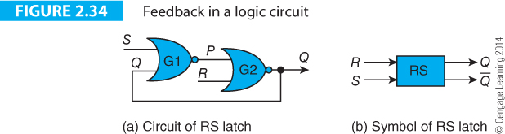
Latches
Figure 2.35 provides the circuit and symbol of a simple latch (output P is labeled Q by convention).
The output of NOR gate G1, P, is connected to the input of NOR gate G2. The output of NOR gate G2 is Q and is connected to the input of NOR gate G1. This circuit employs feedback, because the input is defined in terms of the output; that is, the value of P determines Q, and the value of Q determines P.

Slide 72
Inputs |  |  | Output
R | S | Q | Q⁺
0 | 0 | 0 | 0
0 | 0 | 1 | 1
0 | 1 | 0 | 1
0 | 1 | 1 | 1
1 | 0 | 0 | 0
1 | 0 | 1 | 0
1 | 1 | 0 | ?
1 | 1 | 1 | ?

Slide 73
Inputs |  | Output | Description
R | S | Q⁺
0 | 0 | Q | No change
0 | 1 | 1 | Set output to 1
1 | 0 | 0 | Reset output to 0
1 | 1 | X | Forbidden

Slide 74
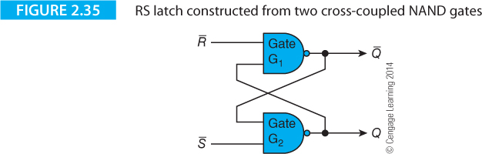
Inputs |  | Output | Comment
R | S | Q⁺
0 | 0 | X | Forbidden
0 | 1 | 1 | Reset output to 0
1 | 0 | 0 | Set output to 1
1 | 1 | Q | No change

Slide 75
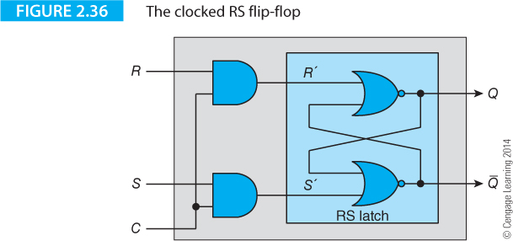
Clocked RS Flip-flops
The RS latch responds to its inputs according to its truth table. Sometimes we want the RS latch to ignore its inputs until a specific time. The circuit of Figure 2.36 demonstrates how we can turn the RS latch into a clocked RS flip-flop.

Slide 76
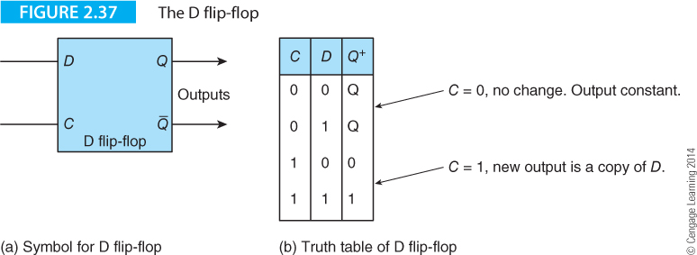
D Flip-flop
The D flip-flow that has a D (data) input and a C (clock) input. Setting the C input to 1 is called clocking the flip-flop. D flip-flops can be level sensitive, edge triggered or master-slave.

Slide 77
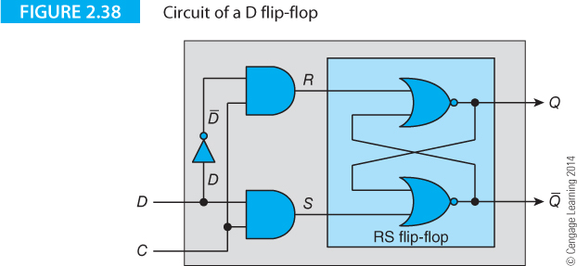

Slide 78
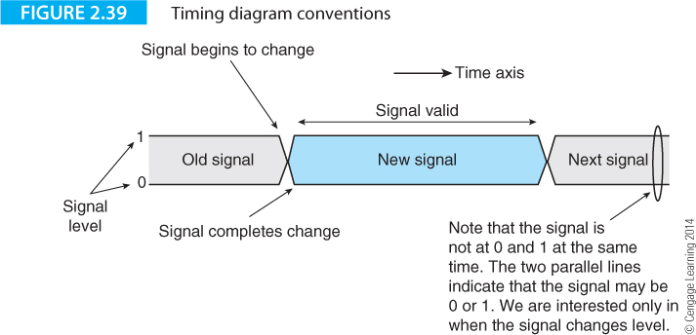
Timing diagrams
Before demonstrating applications of D flip-flops, we introduce the timing diagram that explain the behavior of sequential circuits. A timing diagram shows how a cause creates an effect. Figure 2.41 shows how we represent a signal as two parallel lines at 0 and 1 levels. They imply that this signal may be 0 or 1 (we are not concerned with which level the signal is in). What we are concerned with is the point at which a signal changes its state

Slide 79
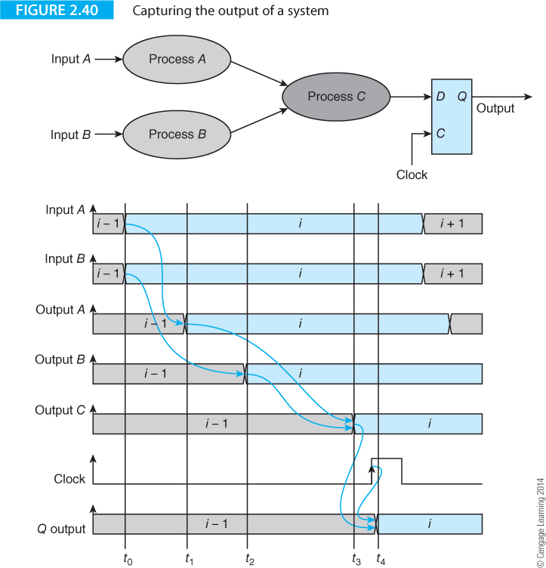
Figure 2.40 demonstrates an application of D flip-flops; sampling (capturing) a time-varying signal. Three processing units A, B, and C each take an input and operate on it to generate an output after a certain delay. New inputs, labeled i, are applied to processes A and B at the time t₀. A process can be anything from a binary adder to a memory device.

Slide 80
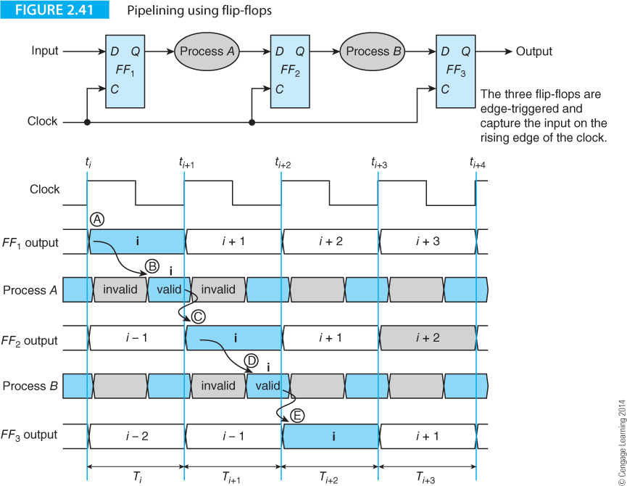
Figure 2.41 extends Figure 2.40 to demonstrate pipelining, in which flip-flops separate processes A and B in a digital system by acting as a barrier between them. The flip-flops in Figure 2.41 are edge-triggered and all are clocked at the same time.

Slide 81
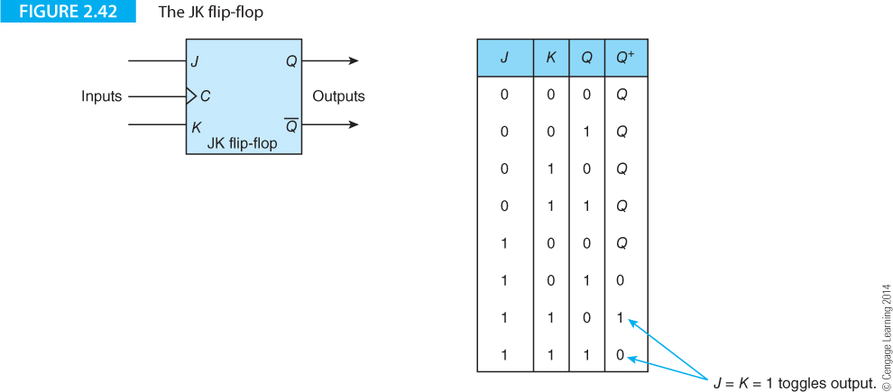
The JK Flip-flop
The JK is the most versatile of all flip-flops.

Slide 82
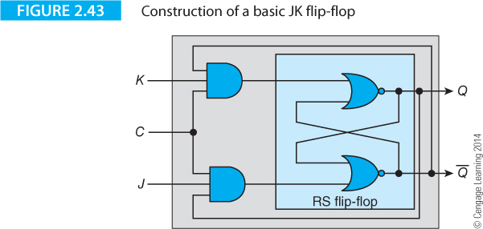

Slide 83
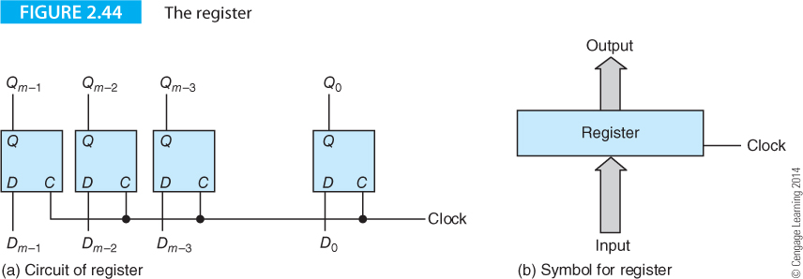
Registers
RS, D and JF flip-flops are the building blocks of sequential circuits such as registers and counters. The register is an m-bit storage element that uses m flip-flops to store an m-bit word.
The clock inputs of the flip-flops are connected together and all flip-flops are clocked together. When the register is clocked, the word at its D inputs is transferred to its Q outputs and held constant until the next clock pulse.

Slide 84
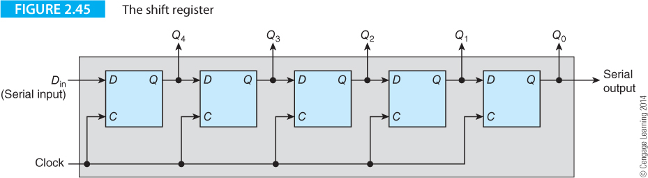
Shift Register
By modifying the structure of a register we can build a shift register whose bits are moved one place right every time the register is clocked. For example, the binary pattern 01110101
becomes 00111010 after the shift register is clocked once
and 00011101 after it is clocked twice
and 00001110 after it is clocked three times, and so on.

Slide 85


Slide 86


Slide 87
Shift type |  | Shift Left |  | Shift Right
Original bit pattern before shift |  | 11010111 |  | 11010111
Logical shift |  | 10101110 |  | 01101011
Arithmetic shift |  | 10101110 |  | 11101011
Circular shift |  | 10101111 |  | 11101011

Slide 88


Slide 89

Asynchronous Counters
A counter does what its name suggests; it counts. Simple counters count up or down through the natural binary sequence, whereas more complex counters may step through an arbitrary sequence. When a sequence terminates, the counter starts again at the beginning. A counter with n flip-flips cannot count through a sequence longer than 2^{n}.

Slide 90


Slide 91

The counter is described as ripple-through because a change of state always begins at the least-significant bit end and ripples through the flip-flops. If the current count in a 5-bit counter is 01111, on the next clock the counter will become 10000.
However, the counter will go through the sequence 01111, 01110, 01100, 01000, 10000 as the 1-to-0 transition of the first stage propagates through the chain of flip-flops.

Slide 92

Using a Counter to Create a Sequencer
We can combine the counter with the multiplexer (i.e., three-line to eight-line decoder) to create a sequence generator that produces a sequence of eight pulses T₀ to T₇, one after another.

Slide 93

Sequential Circuits
A system with internal memory and external is in a state that is a function of its internal and external inputs. A state diagram shows some (or all) of the possible states of a given system. A labeled circle represents each of the states and the states are linked by unidirectional lines showing the paths by which one state becomes another state.
Figure 2.45 gives the state diagram of a JK flip-flop that has two states, S₀ and S₁. S₀ represents Q = 0 and S₁ represents Q = 1. The transitions between states S₀ and S₁ are determined by the values of the JK inputs at the time the flip-flop is clocked

Slide 94
J | K | Condition
0 | 0 | C₁
0 | 1 | C₂
1 | 0 | C₃
1 | 1 | C₄

Slide 95

Buses and Tristate Gates
The final section in this chapter brings together some of the circuits we’ve just covered and hints at how a computer operates by moving data between registers and by processing data.
Now that we’ve built a register out of D flip-flops, we can construct a more complex system with several registers.
By the end of this section, you should have an inkling of how computers execute instructions. First we need to introduce a new type of gate—a gate with a tristate output.

Slide 96
The tristate output lets us do the seemingly impossible and connect several outputs together.
Figure 2.48a is a tristate gate with an active-high control input E (E stands for enable). When E is asserted high, the output of the gate Y is equal to its input X. Such a gate is acting as a buffer and transferring a signal without modification. When E is inactive low, the gate’s output Y is internally disconnected and the gate does not drive the output
.
If Y is connected to a bus, the signal level at Y when the gate is disabled is that of the bus. This output state is called floating because the output floats up and down with the traffic on the bus.

Slide 97

Registers, Buses and Functional Units
We can now put things together and show how very simple operations can be implemented by a collection of logic elements, registers and buses.
The system we construct will be able to take a simple 4-bit binary code IR₃,IR₂,IR₁,IR₀ and cause the action it represents to be carried out.
Figure 2.50 demonstrates how we can take the four registers and a bus to create a simple functional unit that executes MOVE instructions.

Slide 98
A MOVE instruction is one of the simplest computer instructions that copies data from one location to another; in high level language terms it is equivalent to the assignment Y = X. The arrangement of Figure 2.57 employs two 2-line to 4-line decoders to select the source and destination registers used by an instruction. This structure can execute a machine level operation such as MOVE Ry,Rx that is defined as
[Ry] ← [Ri].

Slide 99

The instruction register uses bits IR₁, IR₀ to select the data source. The 2-line to 4-line decoder side of the diagram decodes bits IR₁, IR₀ into one of four signals: E₀, E₁, E₂, E₃. The register enabled by the source code puts its data on the bus, which is fed to the D inputs of all registers. The 2-bit destination code IR₃, is fed to the decoder to generate one of the clock signals C₀, C₁, C₂, C₃. All the AND gates in this decoder are enabled by a common clock signal, so that the data transfer does not take place until this line is asserted.

Slide 100

Figure 2.59 extends the system further to include multiple buses and an ALU (arithmetic and logic unit).
An operation is carried out by enabling two source registers and putting their contents on bus A and bus B.
These buses are connected to the input terminals of the arithmetic and logical unit that produces an output depending on the function the ALU is programmed to perform.

